Slide 1
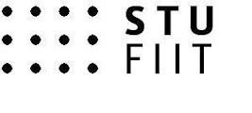

KD¹
Up to the starting line
Michal Kováč
brAInworks labs
Faculty of Informatics and Information Technologies STU

Slide 2


Connecting flights
IAU_B: Intelligent analysis of information
DSP_B: Data science programming

Slide 3
What is this course about and what it is not
Knowledge discovery is focused to ML model building and interpreting. It is not intended as a replacement of IAU_B, nor courses dedicated to web scraping and text processing, such as VINF_I.
It is not a primer into deep learning (NSIETE_I) , although we will touch that topic briefly.
It assumes some knowledge of statistics, roughly within the curriculum of PAS_B. Deeper knowledge of Bayesian statistics is not assumed.

Slide 4
Course structure
Lectures 1-6 (statistical learning), 7-10 (decision rules, Bayer)
Live Demos
Tutorials (Basic of R programming, first 2 weeks + pre-study)
Labs (week 1-6)
Miniprojects 3x (week 7-8, 9-10, 11-12), work in pairs
Minitests 4x (random)
Assessments (1x)

Slide 5
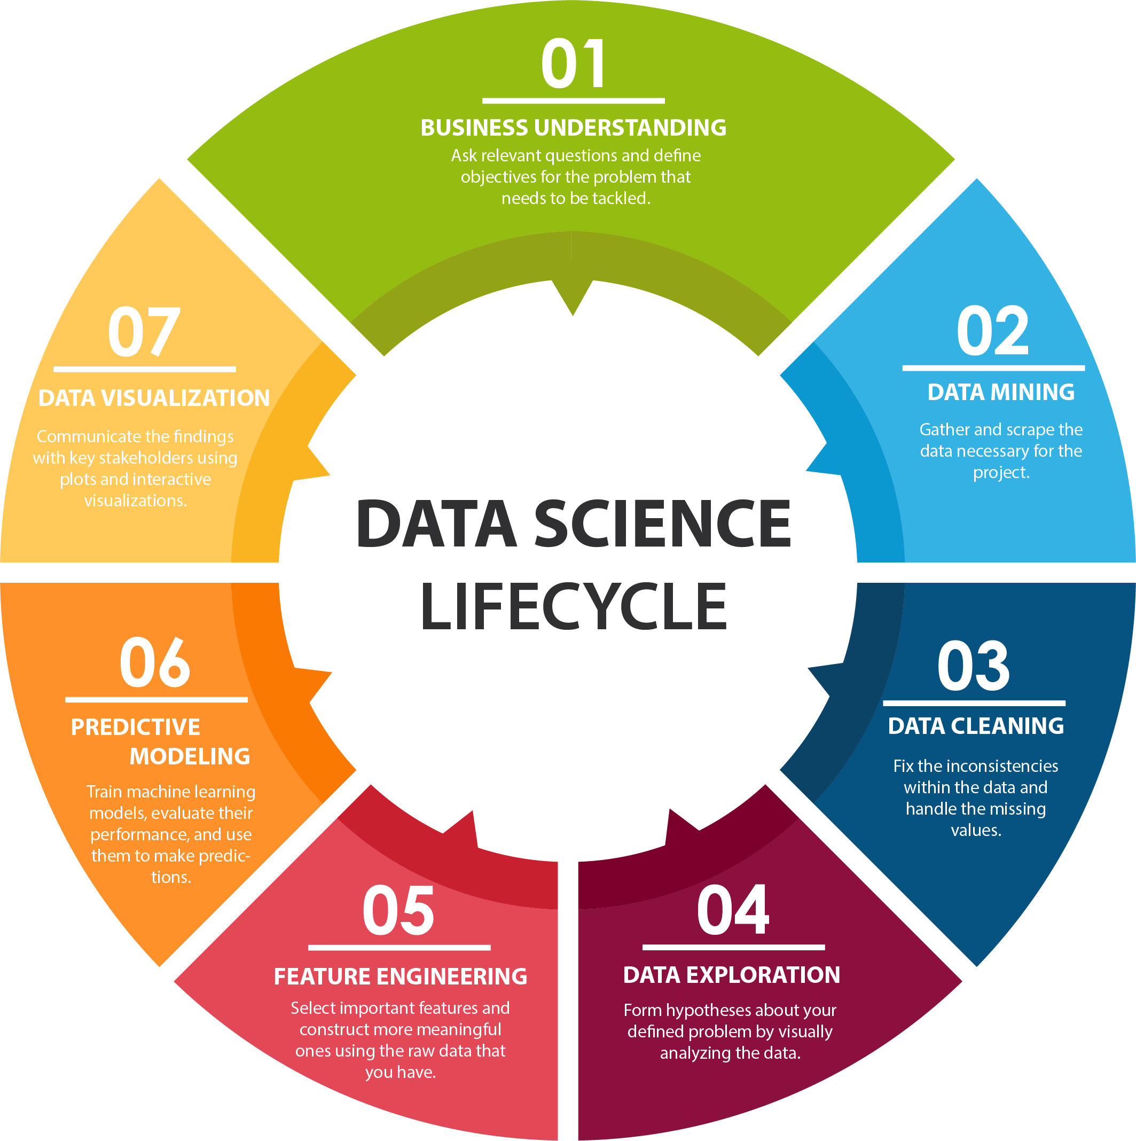
IAU_B: L1: Introduction to DS
KD_I: L1: Up to the starting line
IAU_B: L2: Introduction to data processing in Python
KD_I: L3: Tidyverse: R dialect for data wrangling
IAU_B: L11: Big data processing
IAU_B: L4: Data gathering and integration
IAU_B: L12: Numerical simulations
KD_I: L8: Unsupervised learning, PCA, PCR
IAU_B: L10: Decision trees
IAU_B: L6: Data cleaning and preprocessing
KD_I: L7: Lasso, ridge regression and splines
IAU_B: L6: NLP
IAU_B: L8: Model performance eval.
KD_I: L6: Classification problems II.
KD_I: L5: Classification problems I.
IAU_B: L9: Linear and logistic regression
KD_I: L4: Regression problems
IAU_B: L3: EDA and data visualization
IAU_B: L5: EDA: hypothesis testing
KD_I: L2: DS project anatomy

Slide 6
How to pass
30 points for 3 miniprojects: week 7-8, 9-10, 11-12
20 points for 4 minitests during semester
50 points for final exam
Collect at least 50% from each.

Slide 7
Grading
A: 92-100 B: 83-92 C: 74-83 D: 65-74 E: 56-65
FX: 0-56

Slide 8
Resources

Slide 9




R
A free software environment for statistical computing and graphics.
R Studio
Integrative IDE approach for R and Python applications in data science.
https://www.r-project.org/
https://www.rstudio.com/
Tidyverse
An opinionated collection of R packages designed for data science.
Tidymodels
A collection of packages for modelling and machine learning.
https://www.tidyverse.org/
https://www.tidymodels.org/

Slide 10
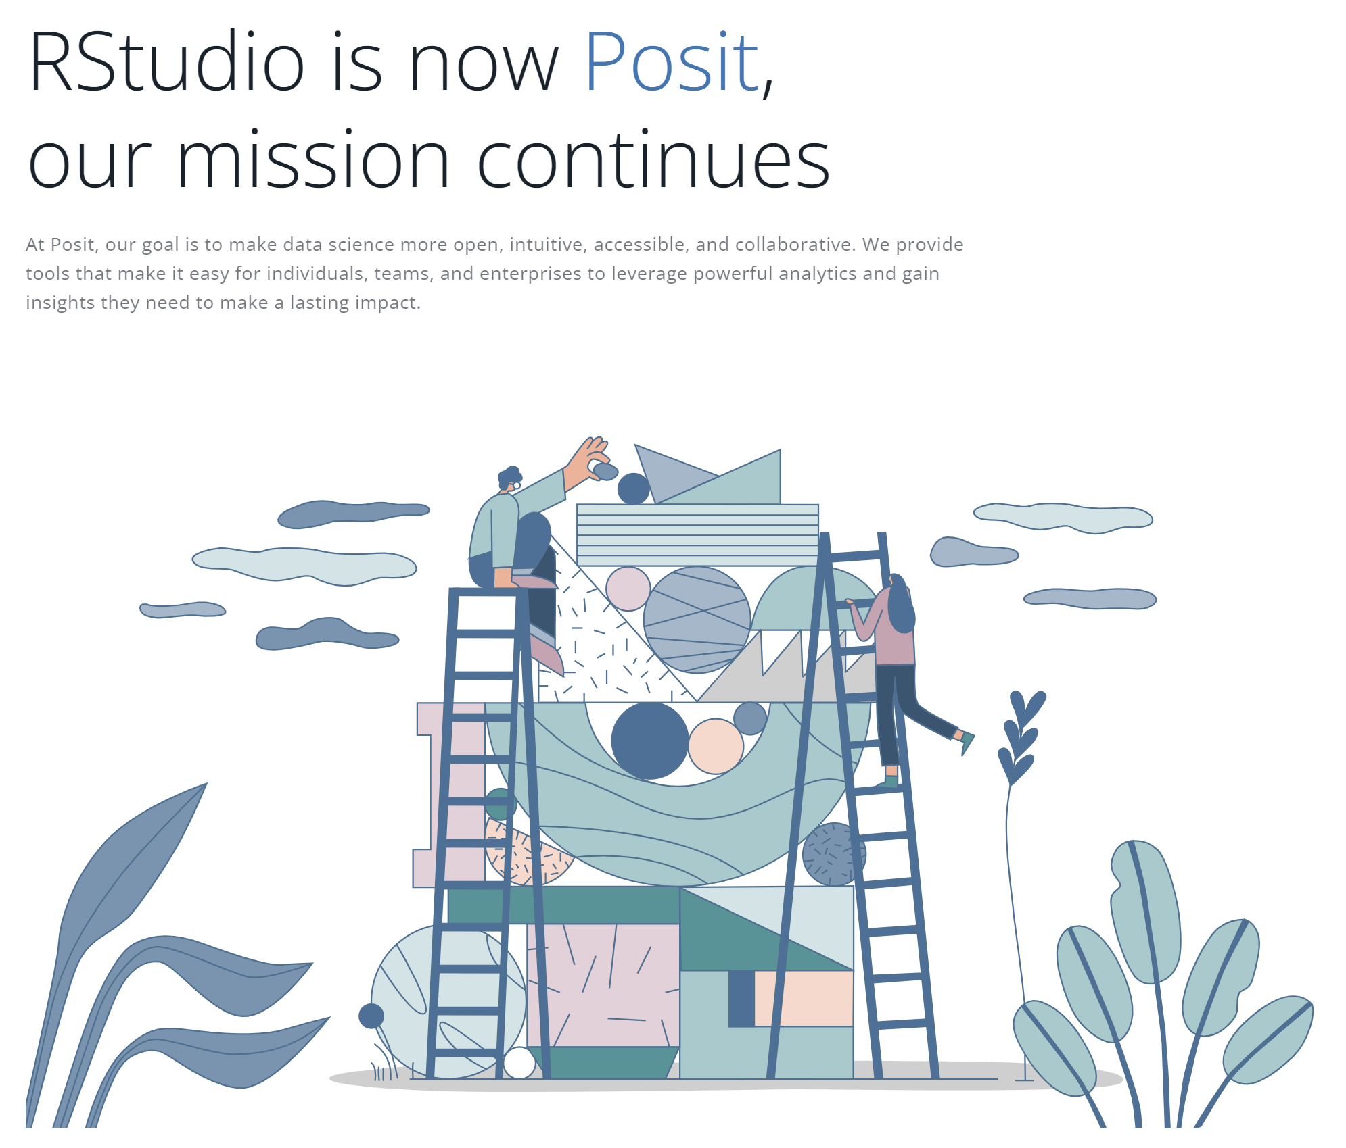

Slide 11
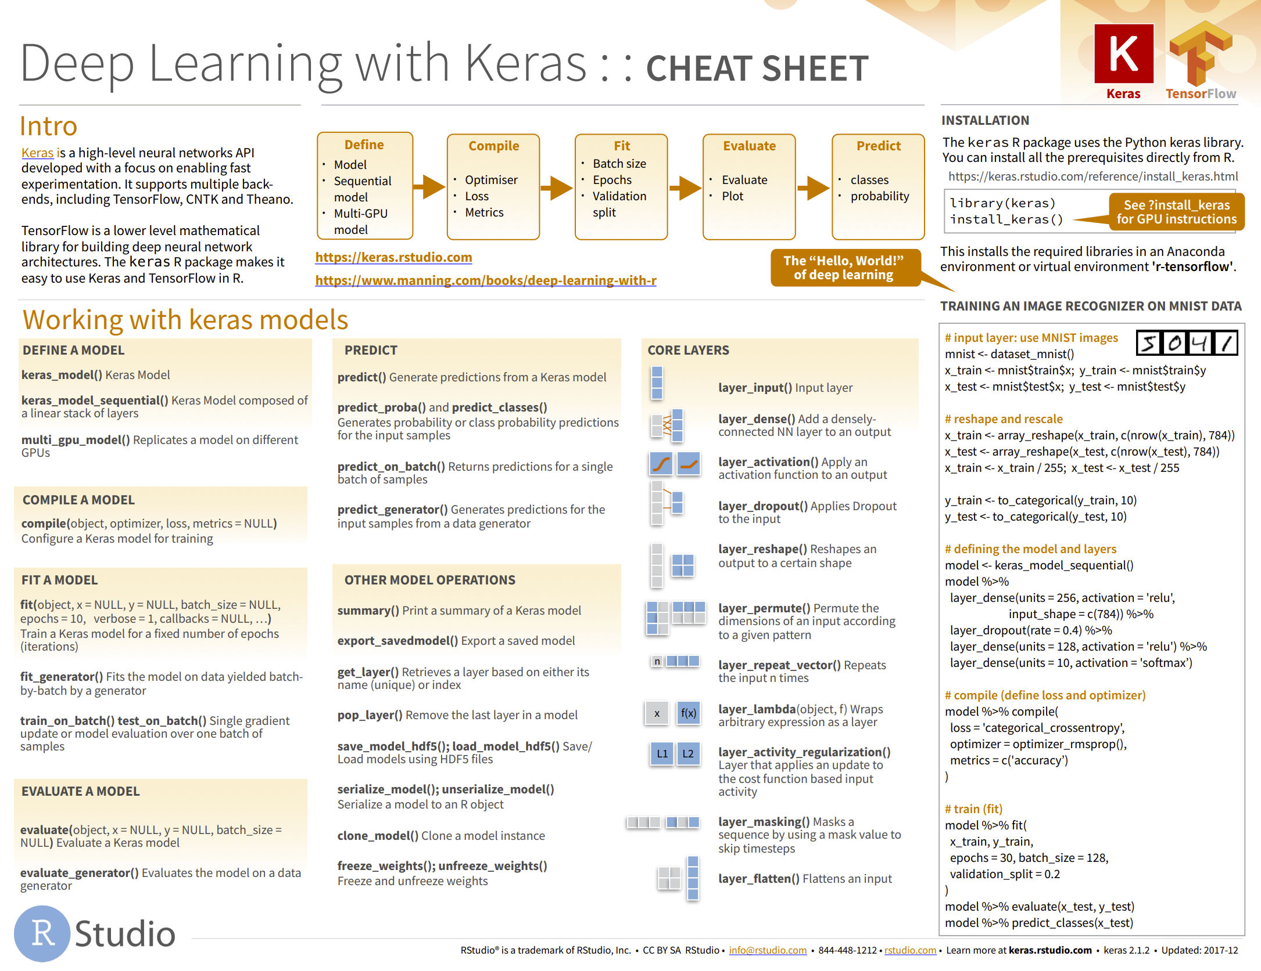

R cheat sheets
Quick reference and summaries for some of the key packages.
https://www.rstudio.com/resources/cheatsheets/

Slide 12
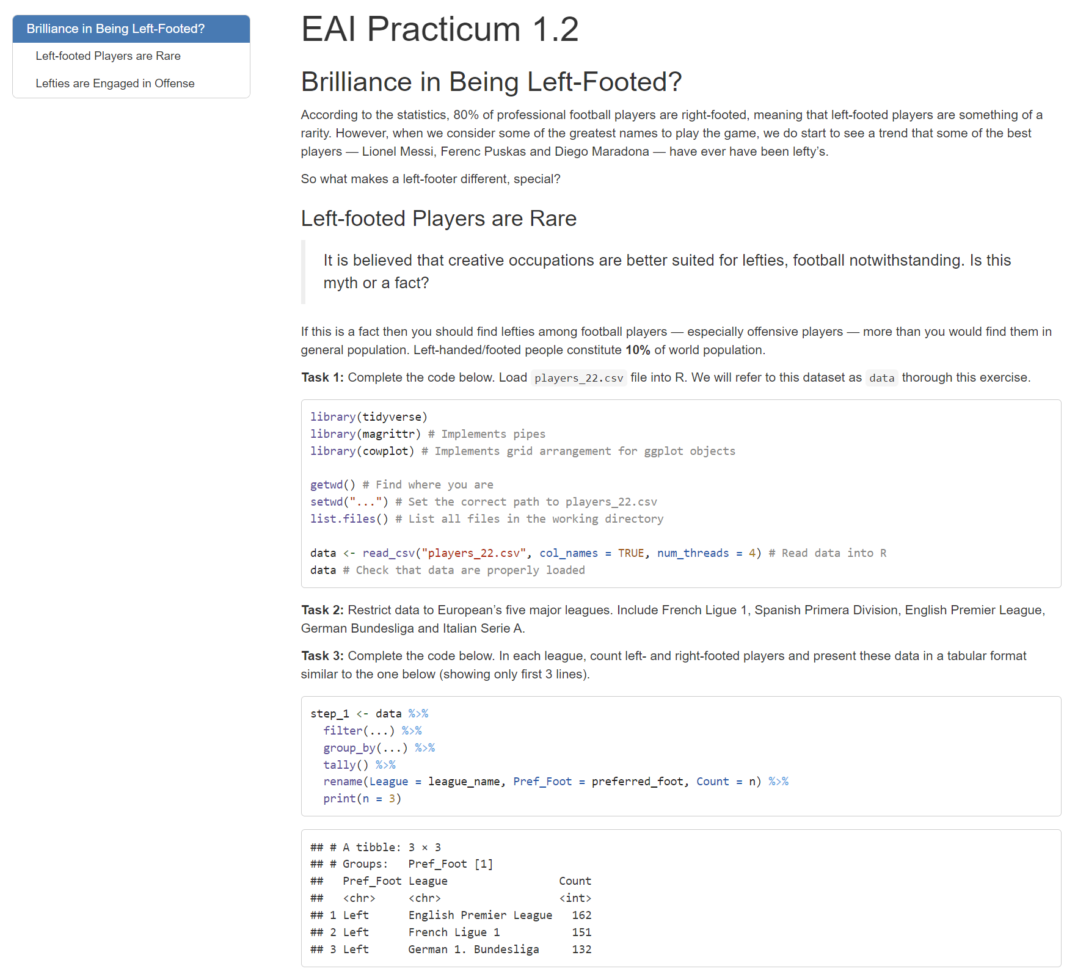
Tutorials
Will improve your survivability during first few weeks.

Slide 13
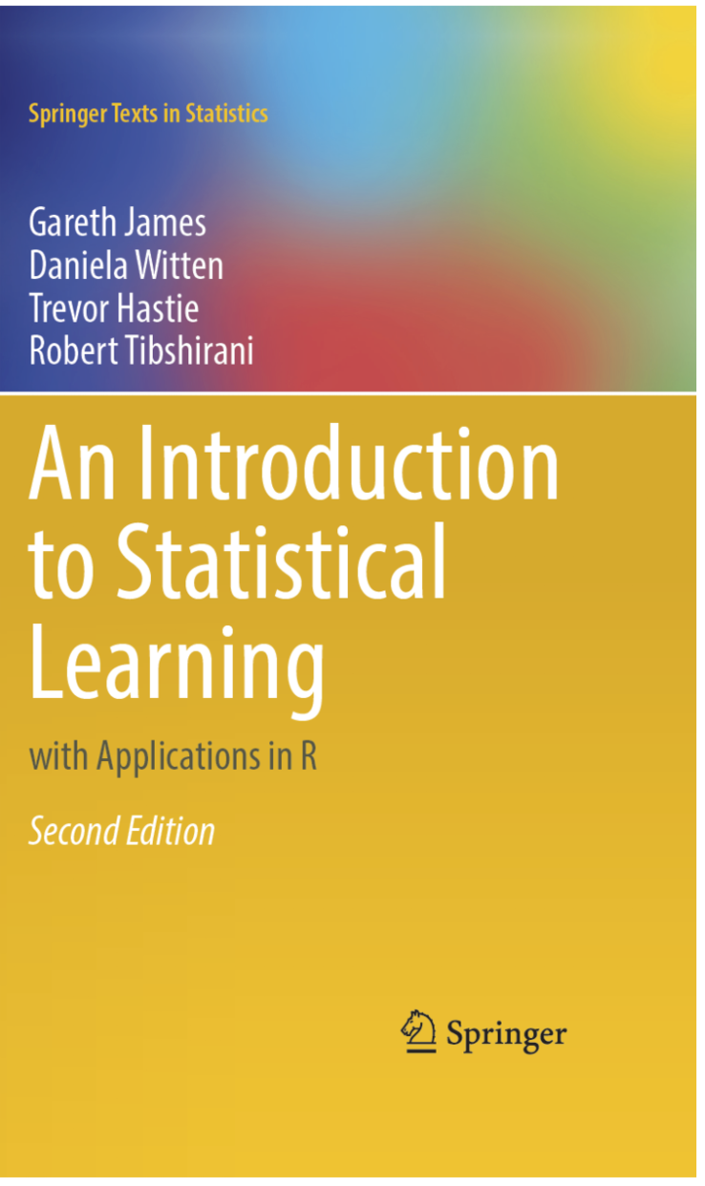

An introduction to Statistical Learning
Gareth James, Daniela Witten, Trevor Hastie, Robert Tibshirani
Publisher: Springer; 1st ed. 2013, Corr. 7th printing 2017 edition, 2nd ed. 2021
Language: English
Hardcover: 440 pages
ISBN-10: ‎1461471370 ISBN-13: 978-1461471370
URL: https://www.statlearning.com/

Slide 14
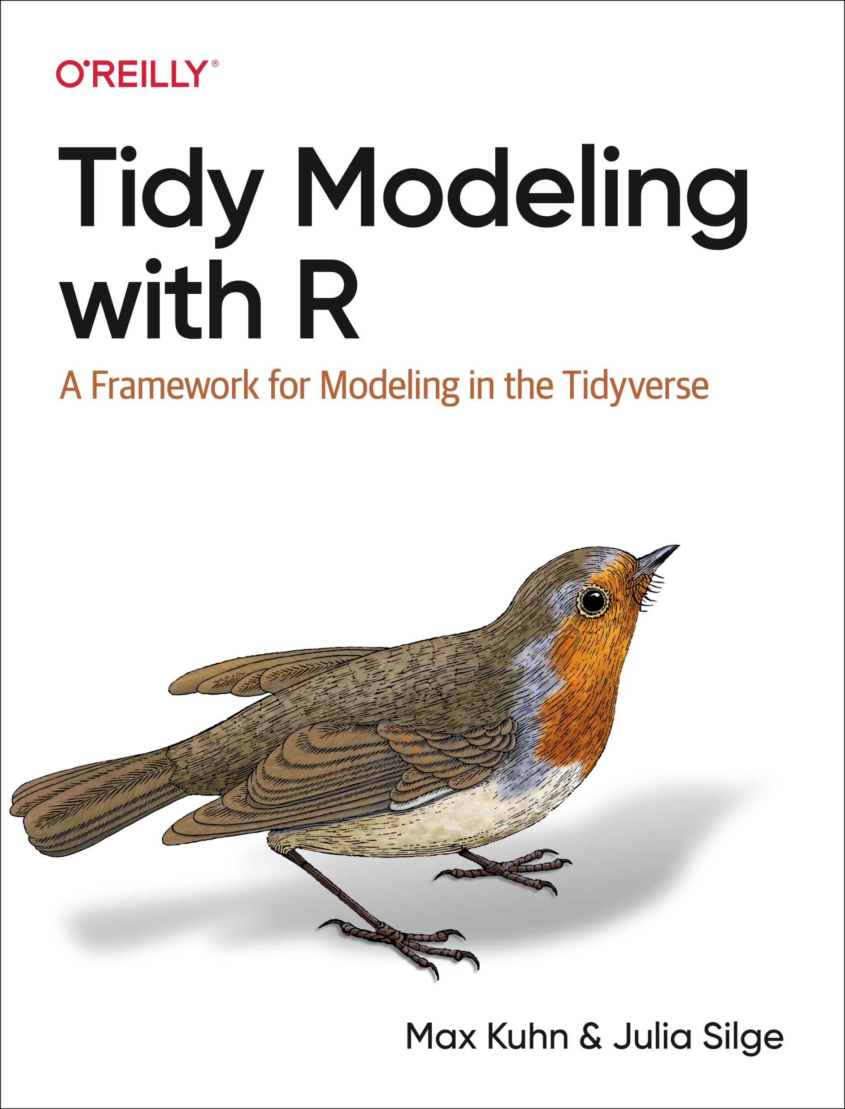

Tidy modelling with R
Max Kuhn and Julia Silge
Publisher: ‎ O'Reilly Media; 1st edition (16 Aug. 2022)
Language: English
Hardcover: 300 pages
ISBN-10: ‎1492096482 ISBN-13: 978-1492096481
URL: https://www.tmwr.org/

Slide 15


R for Data Science
Import, Tidy, Transform, Visualize, and Model Data
Hadley Wickham and Garrett Grolemund
Publisher: O'Reilly Media; 1st edition (January 31, 2017)
Language: English
Hardcover: 518 pages
ISBN-10: 1491910399 ISBN-13: 978-1491910399
URL: https://r4ds.had.co.nz/

Slide 16
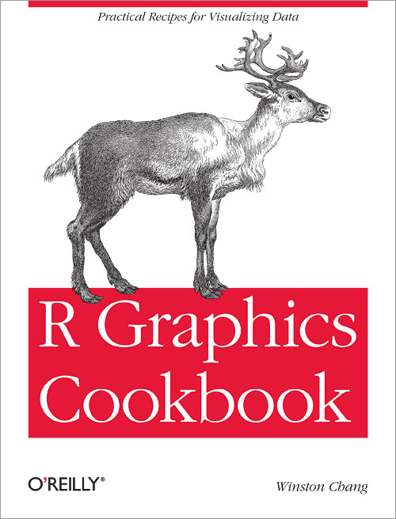

R Graphics Cookbook
Winston Chang
Publisher: ‎ O'Reilly Media; 2nd edition (November 30, 2018)
Language: English
Hardcover: 444 pages
ISBN-10: ‎1491978600 ISBN-13: 978-1491978603
URL: https://r-graphics.org/

Slide 17
What the heck is ML?

Slide 18
Before talking about ML, we should talk about data…
Writing has been developed to store information, not poems. That came millennia later.
90% of current data exist as unstructured data and that has been true for most of human history.

Slide 19
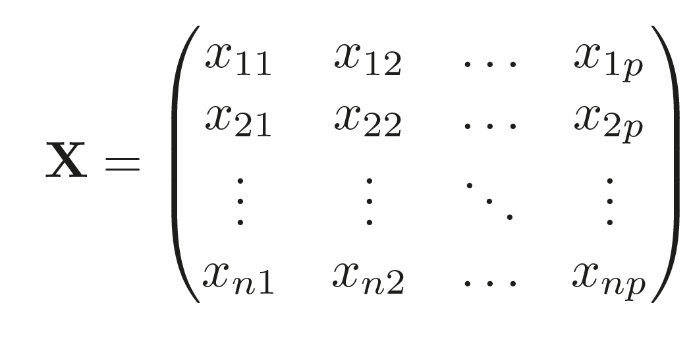
Rectangular data
Attributes/variables/predictors (age, gender, year…)
Observations/values
(patient 1
patient 2
… )
n data points
p variables

Slide 20
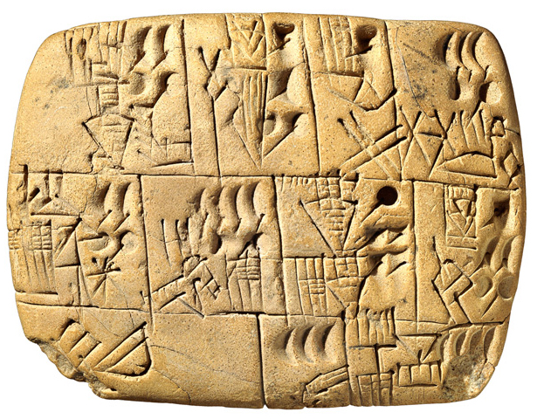

Early writing tablet
About 3100 - 3000 BC
https://podcasts.apple.com/us/podcast/early-writing-tablet/id351096296?i=1000080665177

Slide 21
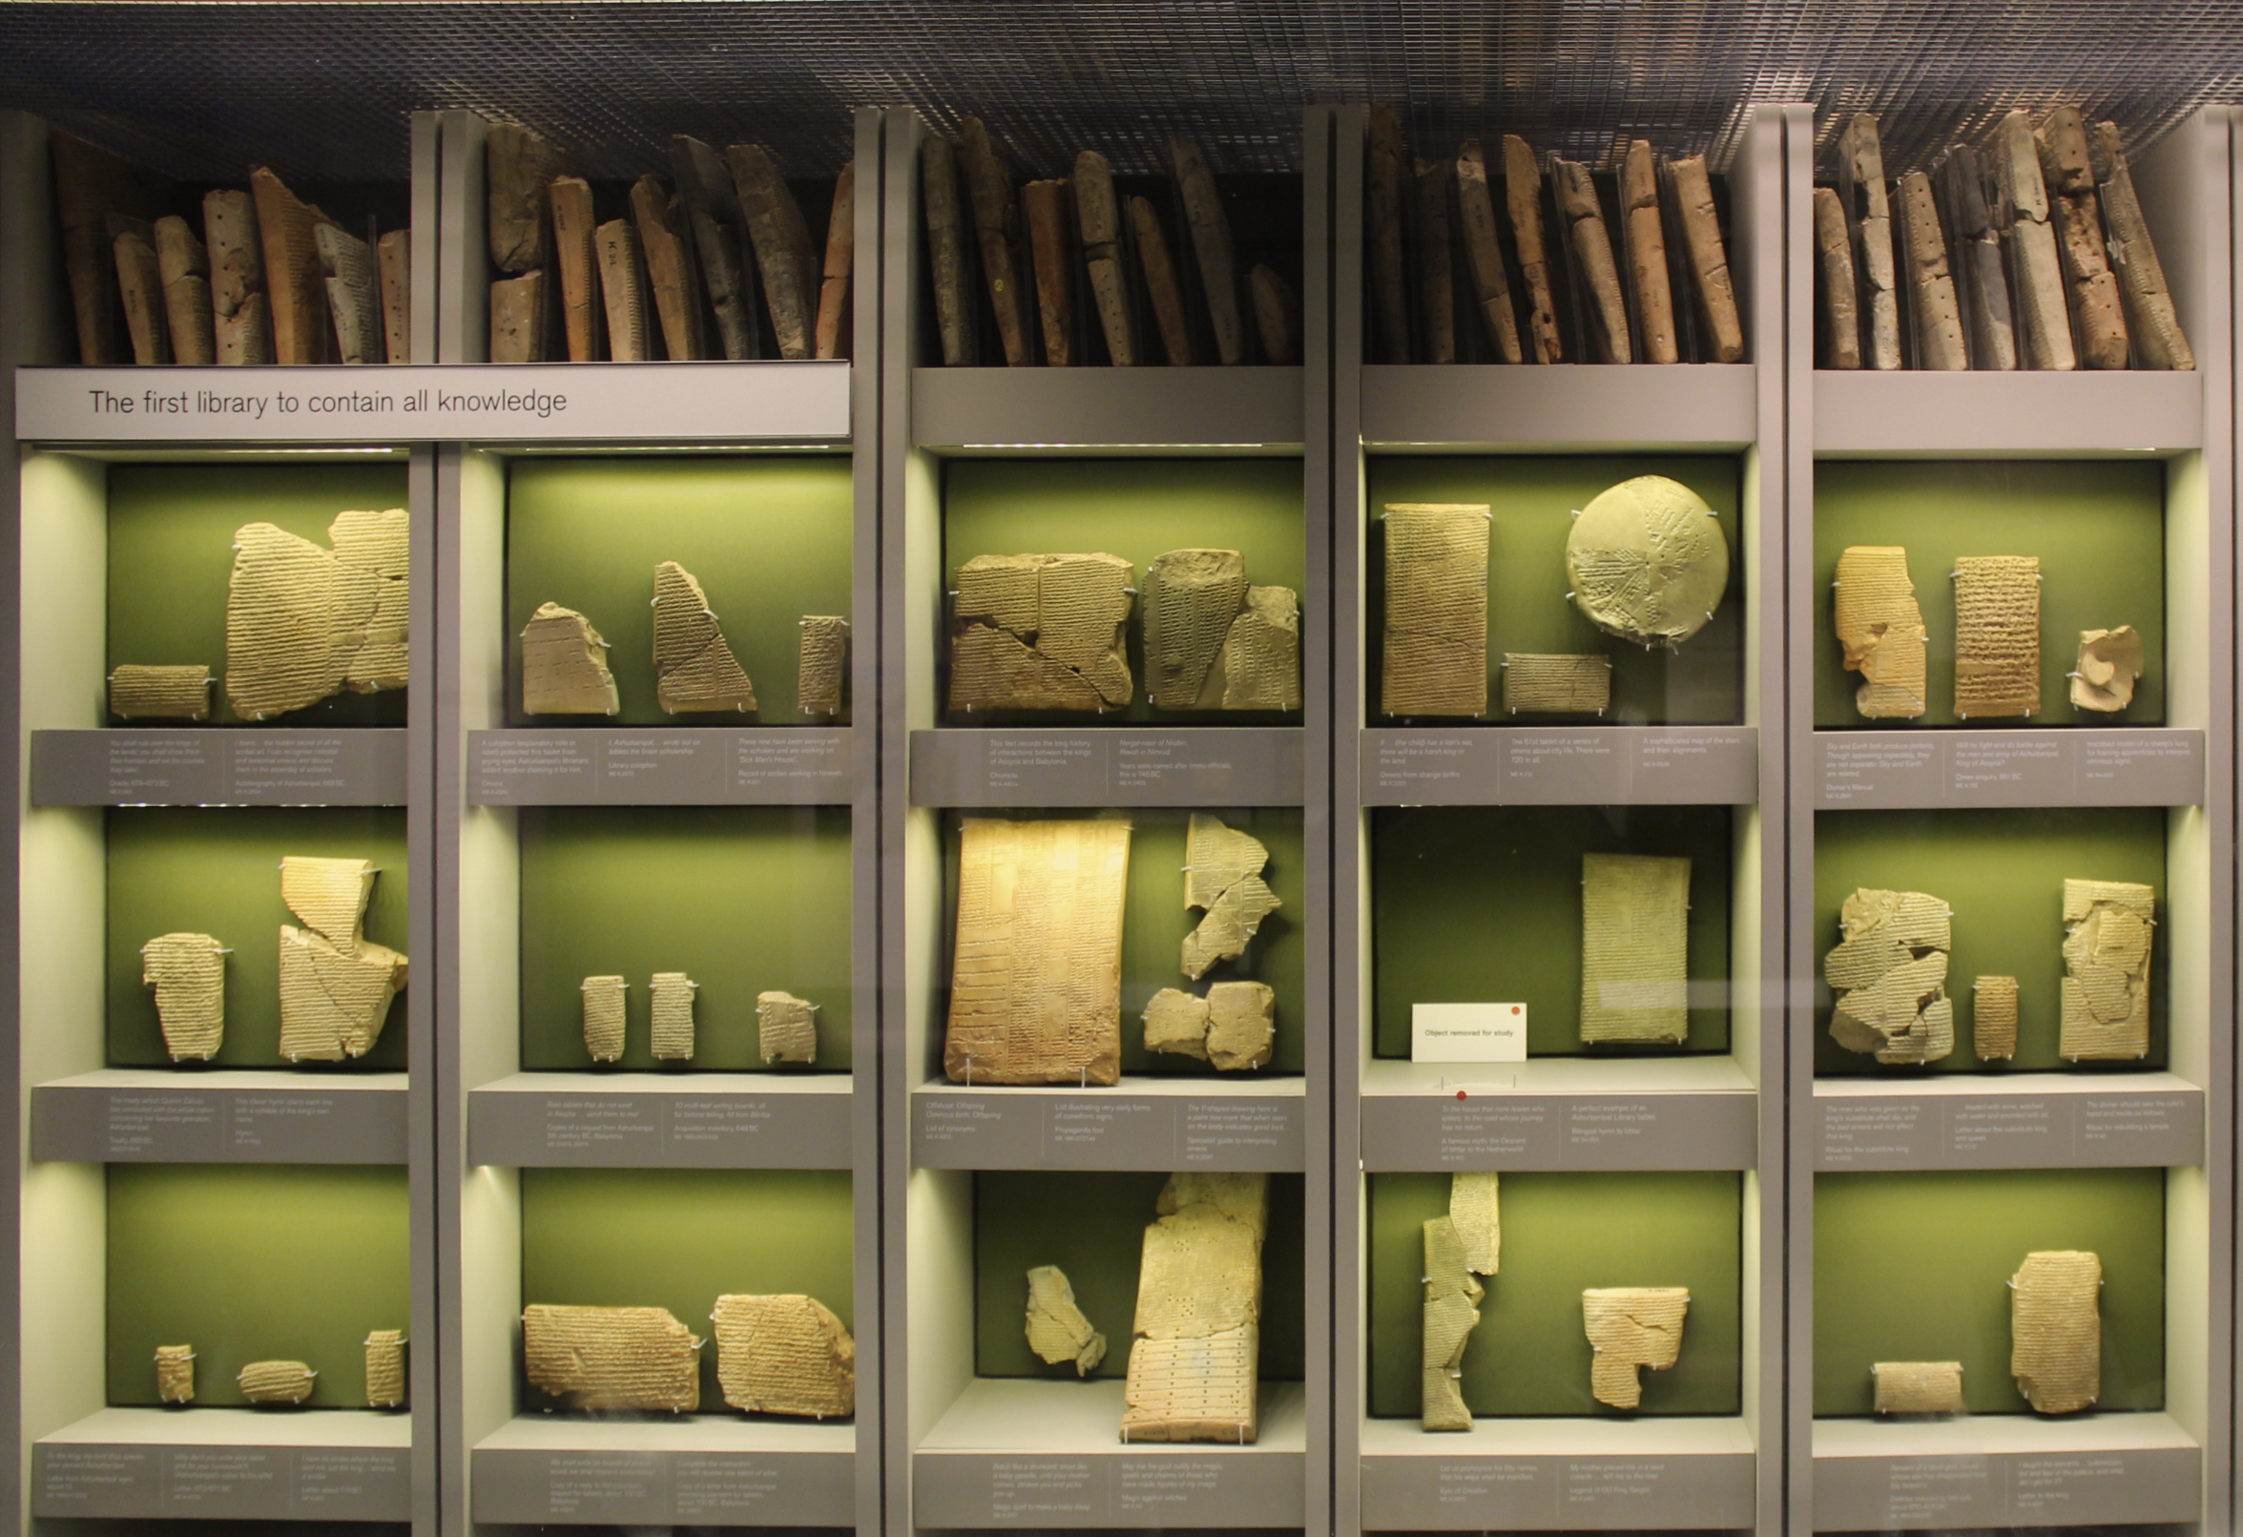

Library of Ashurbanipal About 1500 - 700 BC
https://www.bbc.co.uk/programmes/b00qg5my

Slide 22
Variants of rectangular data
Attributes/variables/predictors (age, gender, year…)
Features (probe 1, probe 2, probe 3, …)
Observations
(patient 1
patient 2
… )
Observations
(patient 1
patient 2
… )
n data points
n data points
p variables
Feature space
p variables
Long format
n of observations > variables p
All observations are labelled
Wide format
n of observations << variables p
All data are unlabelled

Slide 23
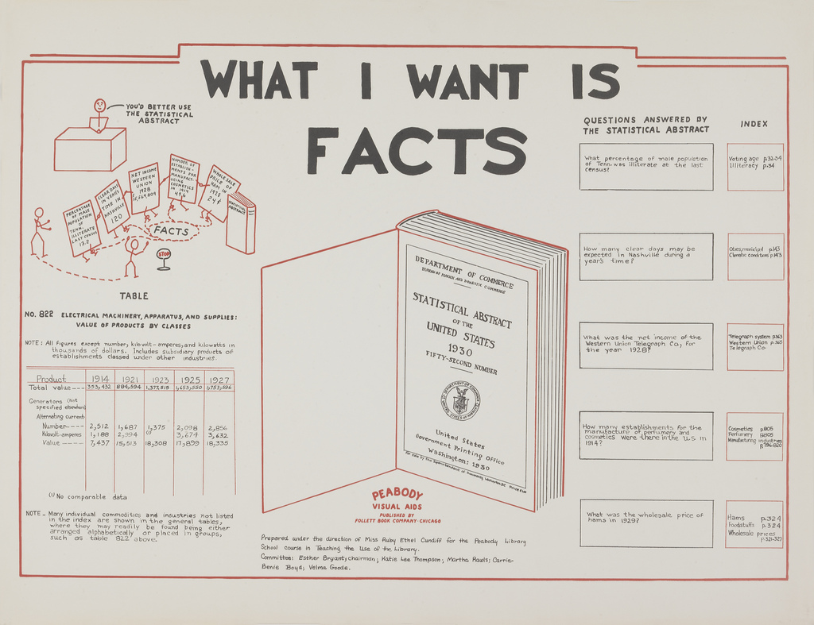

Slide 24

The concept of information need
The concept of information need was developed to encapsulate the motivation that fuels data acquisition and analysis to this very day.
Term coined and popularized by Robert S. Taylor in 1962. According to the theory of information need, knowledge discovery has two main uses:
To retrieve all and only the relevant information in a collection for a particular user with a “particular need”.
Search for patterns in data and when applicable report them to a user.
https://www.researchgate.net/publication/288949939_Information_needs

Slide 25
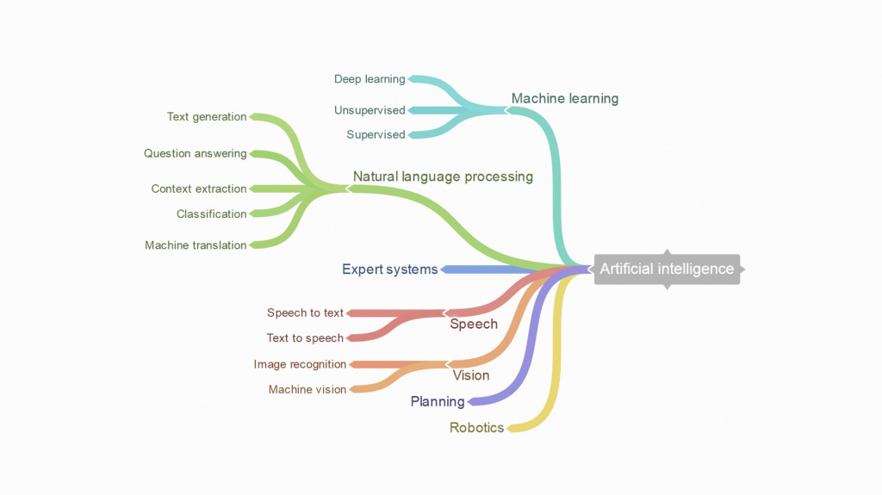

Slide 26

Knowledge retrieval
method “bestiary”

Slide 27
Wide data
All data are unlabeled. Feature selection normally precedes learning.
Long data
All data are labeled. Used for prediction or inference.

Slide 28
Attribute 1
Attribute 2
f
Observations/values
(patient 1
patient 2
… )
n data points
Using long data in ML
Predictor variable
p variables
Dependent variable
As data scientists, our goal is to find the best approach for estimating f .
f is the mapping function that relates predictors to dependent variable. This is what we call a model.

Slide 29

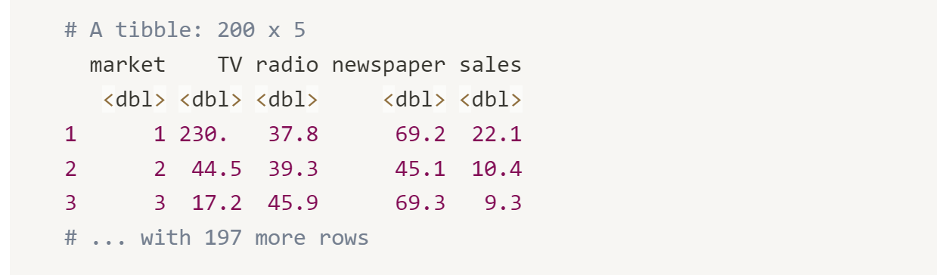
The advertising dataset
Description: The advertising dataset consists of the sales of a product X in 200 different markets, along with advertising budgets for the product in each of those markets for three different media: TV, radio and newspaper.
Format: a Tibble 200 x 5, each attribute encoded as double.

Slide 30
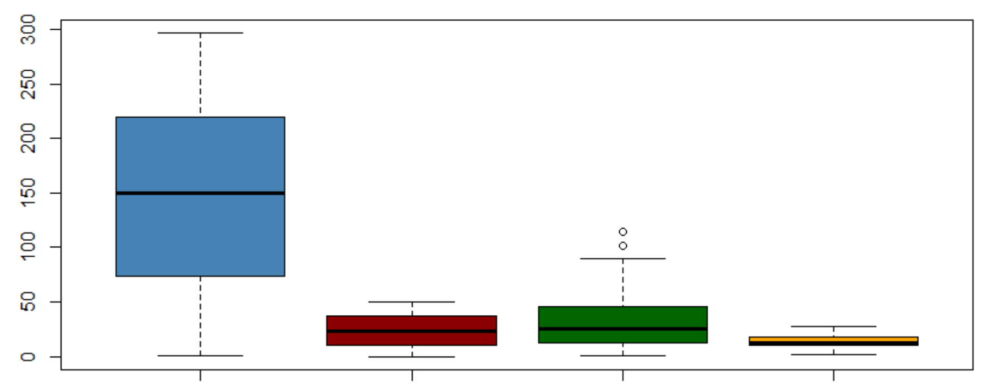
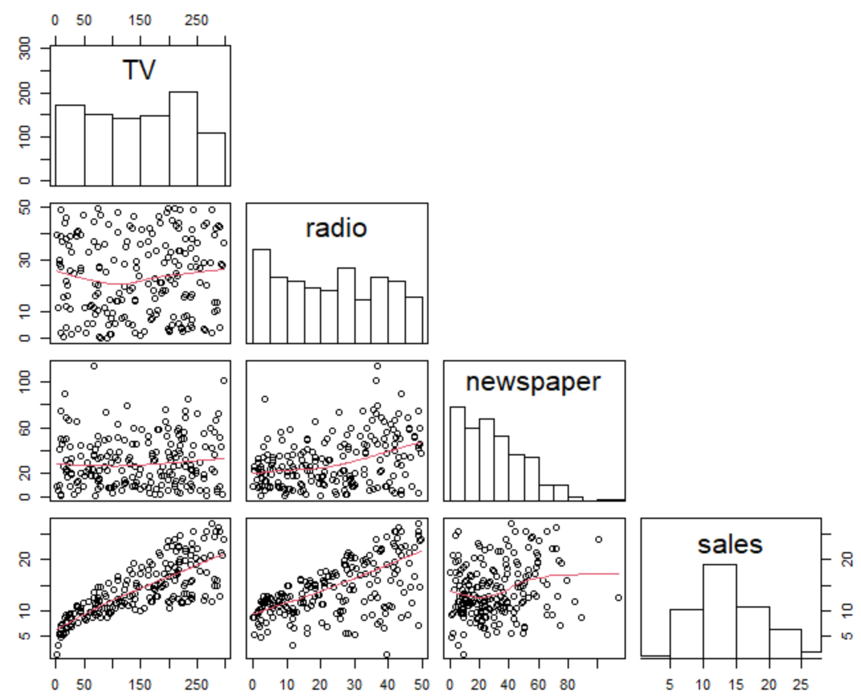
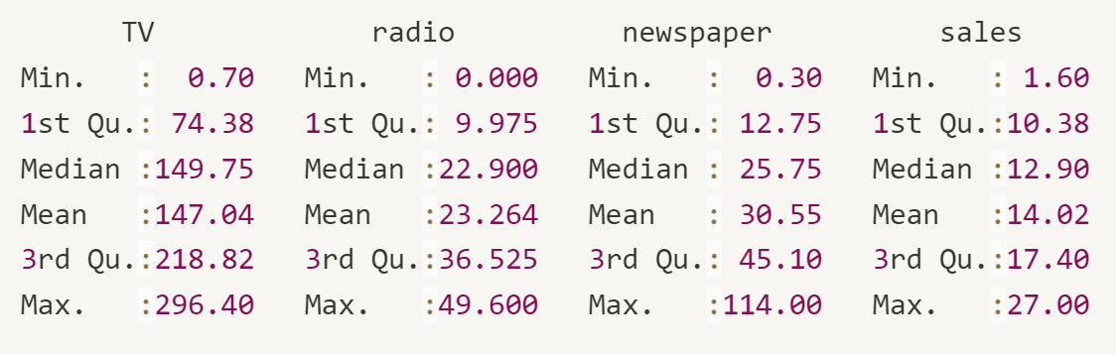

Slide 31
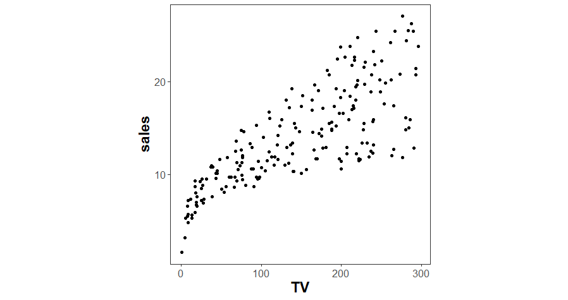
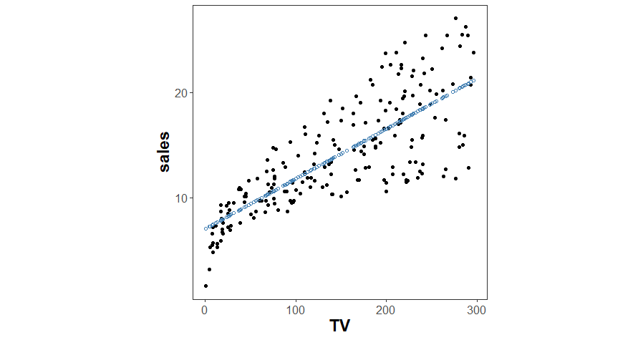
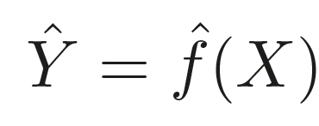
Why estimate f ?
Prediction: use f to approximate y from data such that
Response
Set of readings
Black box
Notes:
Mapovanie 1:1 X na Y

Slide 32
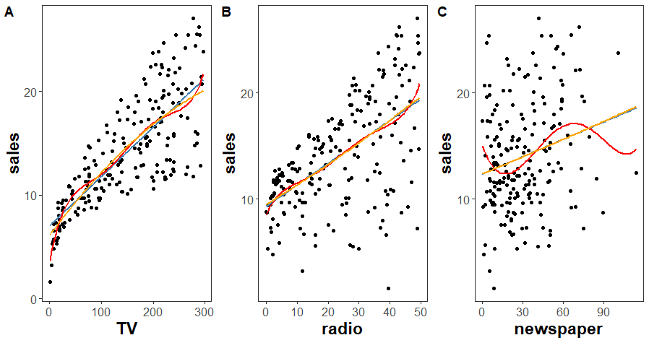
Why estimate f ?
Inference: understand the way that Y is affected as x₁, …, x_{n} change.

Slide 33
How do we fit f onto data?
1.
Make assumption about the function form or shape of f.
2.
Once we assumed that f is, say cubic, the problem of fitting is greatly simplified. No need to estimate p dimensional function f(x), one only needs to estimate p+1 coefficients. .

Slide 34
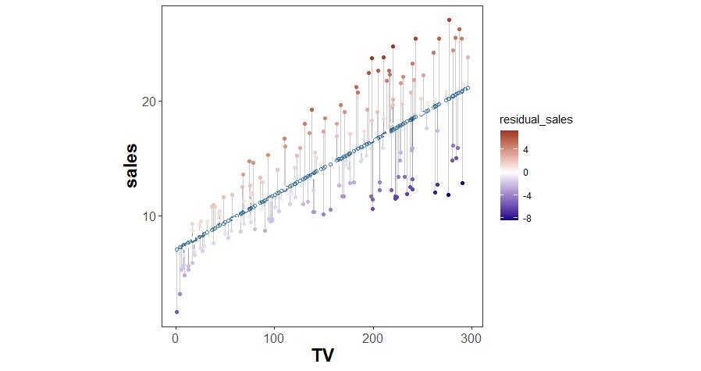
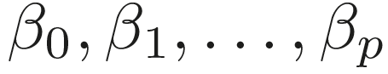
Parametric fitting of f
Make assumption about the function form or shape of f.
Say, f is linear in X such that
Once we assumed that f is linear, the problem of fitting is greatly simplified. No need to estimate p dimensional function f(x), one only needs to estimate p+1 coefficients .
(which we can do by least square fitting, for instance)

Slide 35
Non-parametric estimation of f
Make no explicit assumptions about f.
Fit f to data points as close as possible. Use as many parameters as needed.
Very large number of observation is needed, usually more than available.
Good capture of data, but poor interpretation and potentially poor reproducibility.

Slide 36
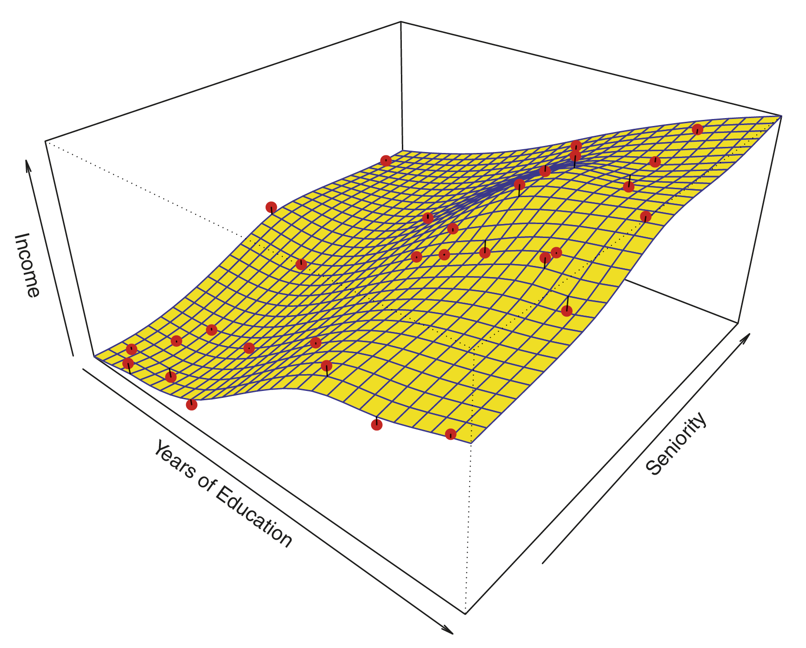
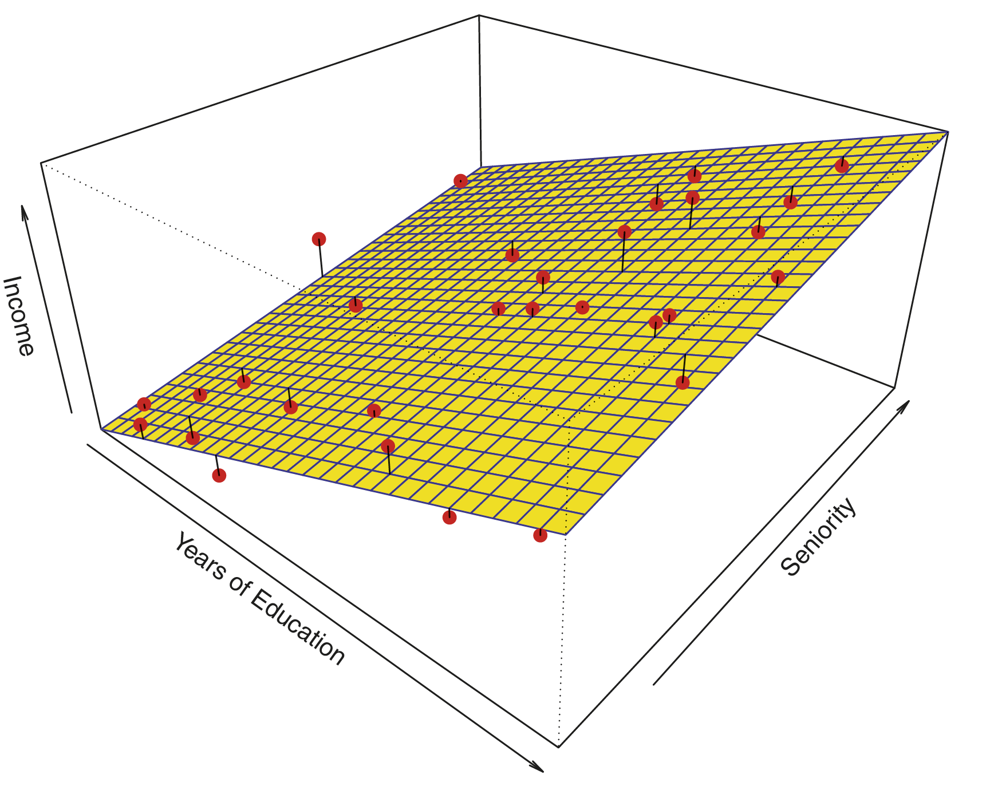
Poor capture:
seniority vs. income
Best capture
but prone to overfitting
Good capture
education vs. income
Linear model fit by least squares
Summarised data with a set of parameters of fixed size
High bias but low variance
Advantage:
Simpler and easy to understand
Less data needed to train and thus faster learning
Disadvantage
Limited complexity → poor fit
Smooth thin-plate spline
ƒ fits data with as many parameters as needed
Low bias but high variance
Advantage:
Flexibility and power: now weak assumptions about ƒ
Disadvantage:
More data needed → slow and prone to overfitting

Slide 37
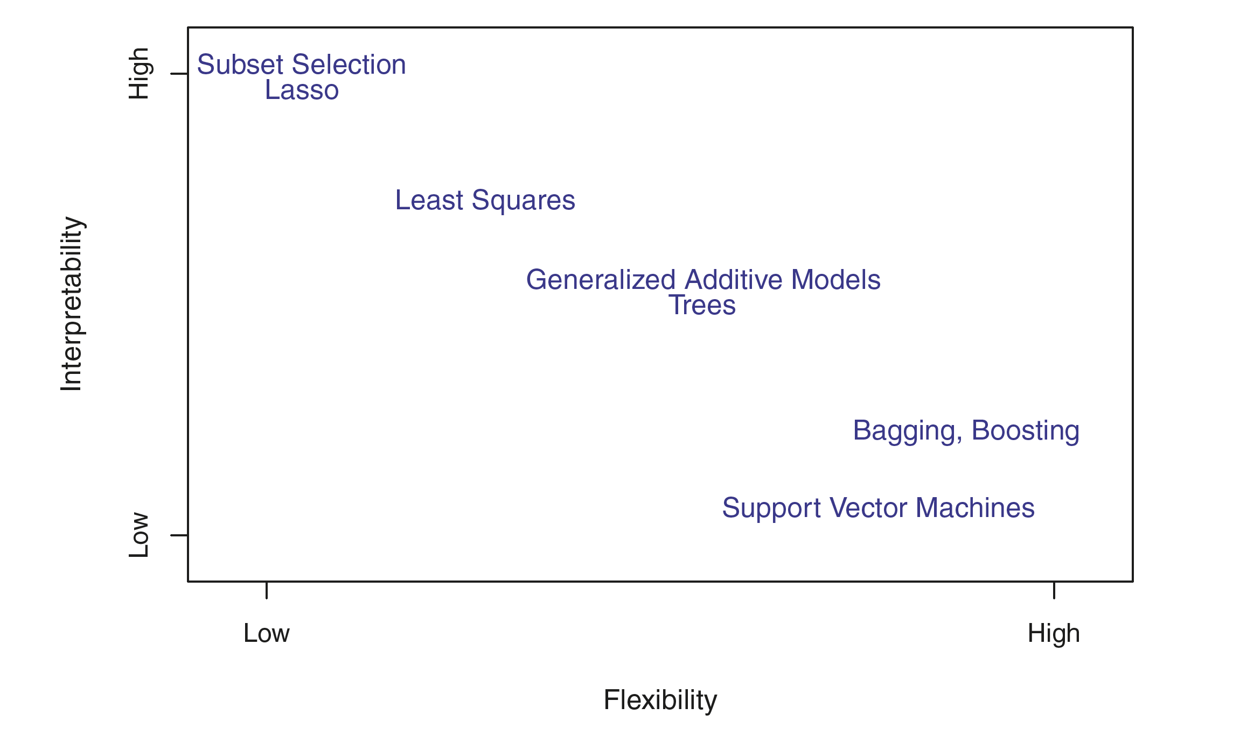
Fitting method choice
Prediction
High interpretability, poor fit
Classification
Low interpretability, good fit

Slide 38
Starting from 80’, statistical learning SL methods (e.g., SVM, DNN) have been introduced with f estimation and model building using:
n of samples << variables p
knowledge discovery is performed on some data (training set) and then validated using the remainder data (testing set),
cross-validation is used by default to estimate over/under-training of SL methods,
whilst prediction/classification being the main goal.

Slide 39
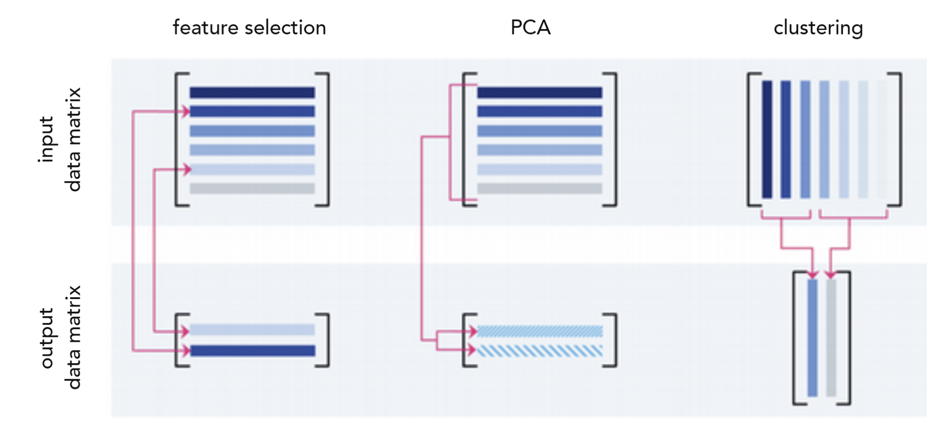
Feature 1
Feature 2
Feature p
Observations/values
(patient 1
patient 2
… )
n data points
Using wide data in ML
Feature space
p features

Slide 40
Unsupervised learning
In some situations, we have for each observation of the predictor measurement x_{i}, i=1,2,…,n, there is no associated response y_{i}.
Thus, it is not possible to fit, say, linear model because there is no y to predict. But, we can still do things like data clustering and dimension reduction.
Goal: we want to ascertain whether the observation fall into distinct groups on the basis of x₁, x₂, …, x_{n}.

Slide 42
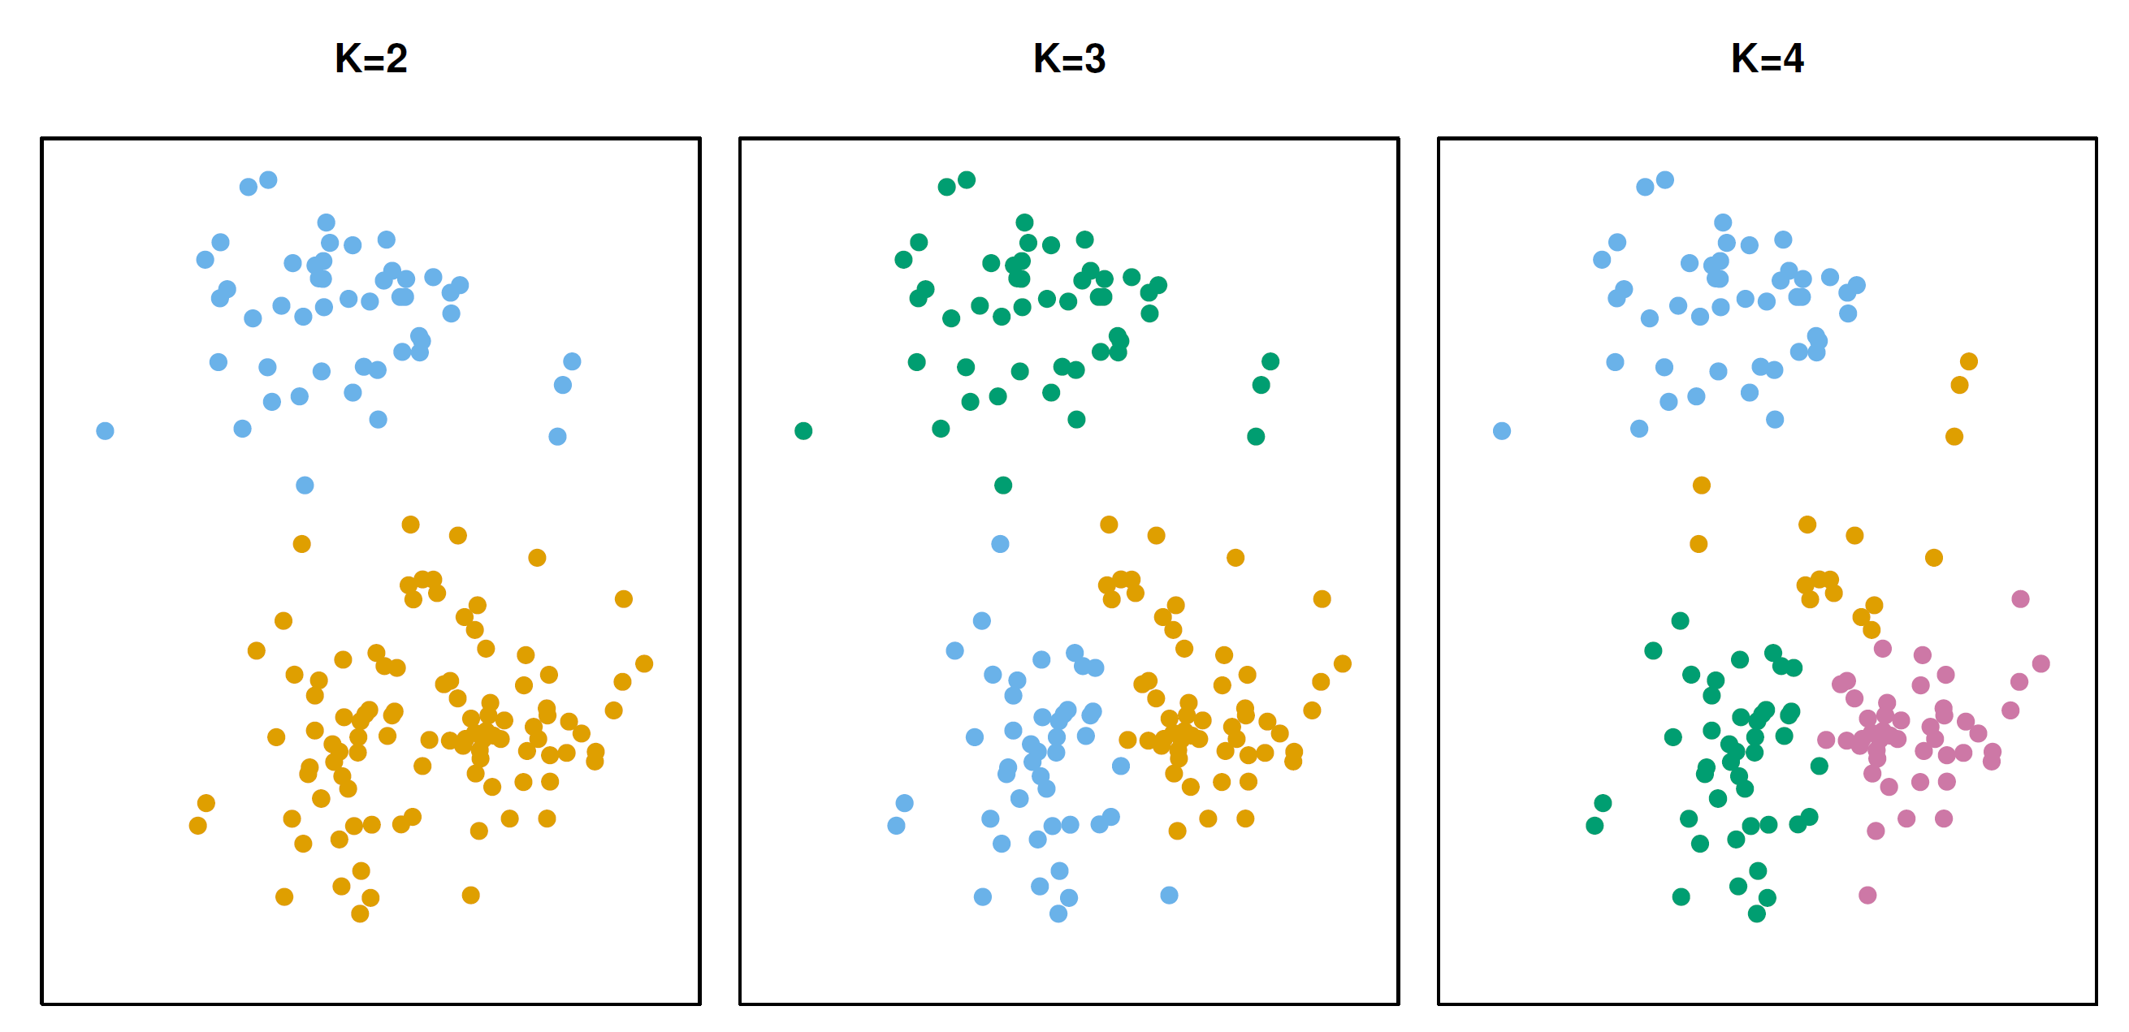
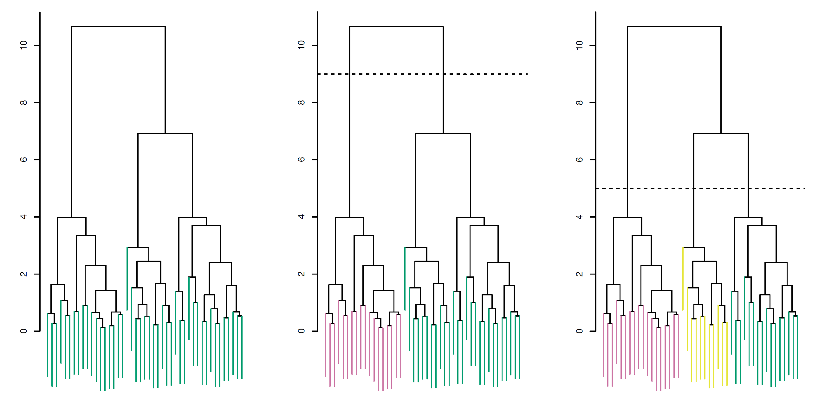
Clusters
Dendrograms
Class 1
Class 1
Class 1
Class 2
No threshold
Completely different
Threshold
max value
Threshold
Measure of similarity
Closely similar
Feature 2
0
Feature 1
Class 3
0
max value
Class 4
Class 2
Class 3
Class 1
Class 1
Class 2
Class 1
Class 2
Class 2
Class 3
Clustering is a data mining technique which groups unlabeled data based on their similarities or differences. These algorithms are used to process raw, unclassified data objects into groups represented by structures or patterns in the information.

Slide 43
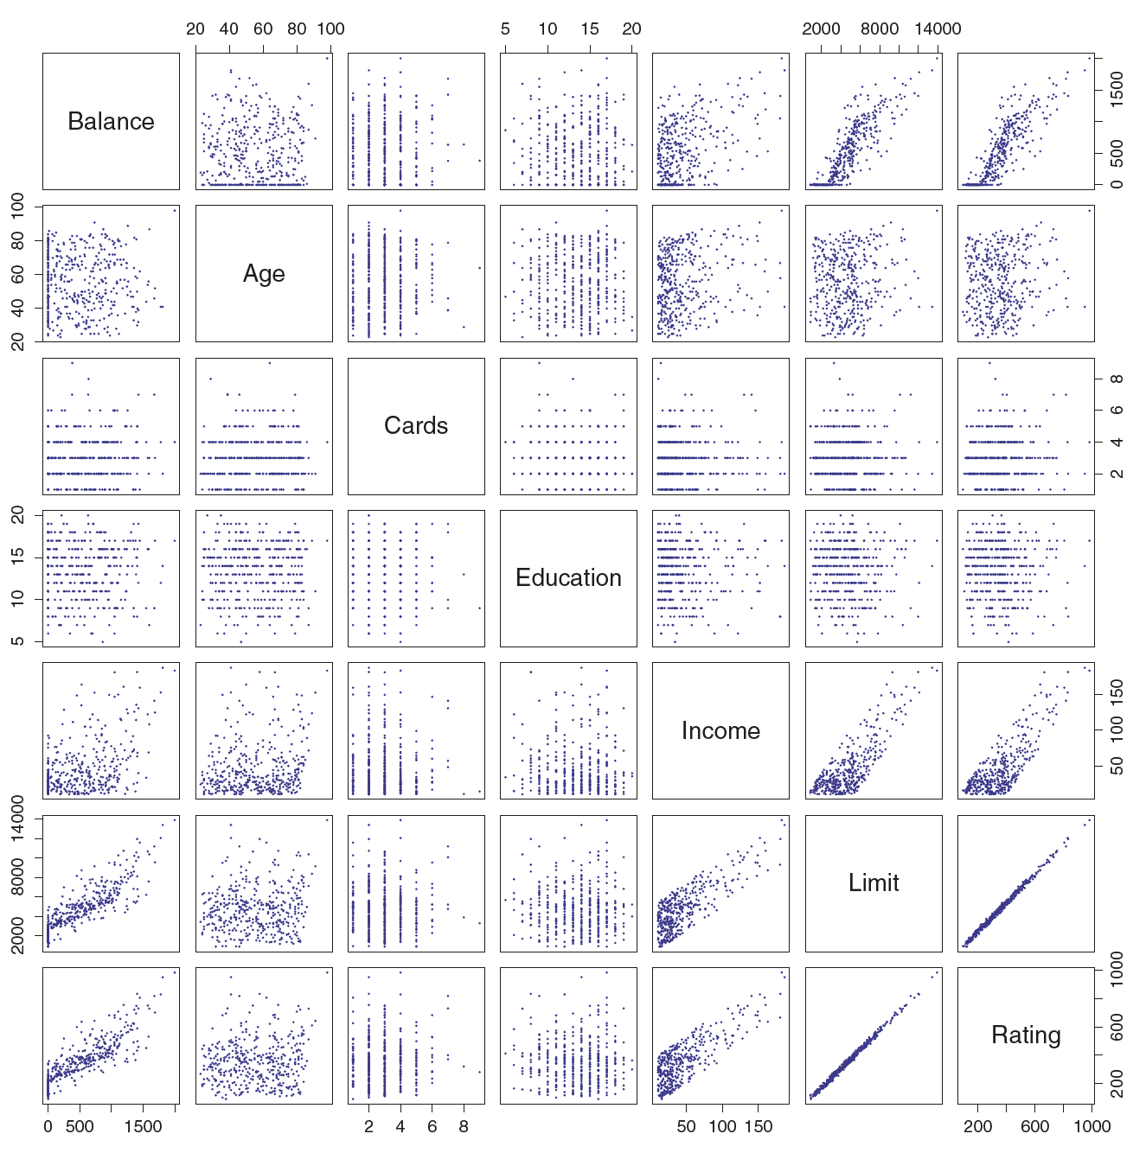
Credit dataset An Introduction to Statistical Learning
https://www.statlearning.com/resources-second-edition

Slide 45
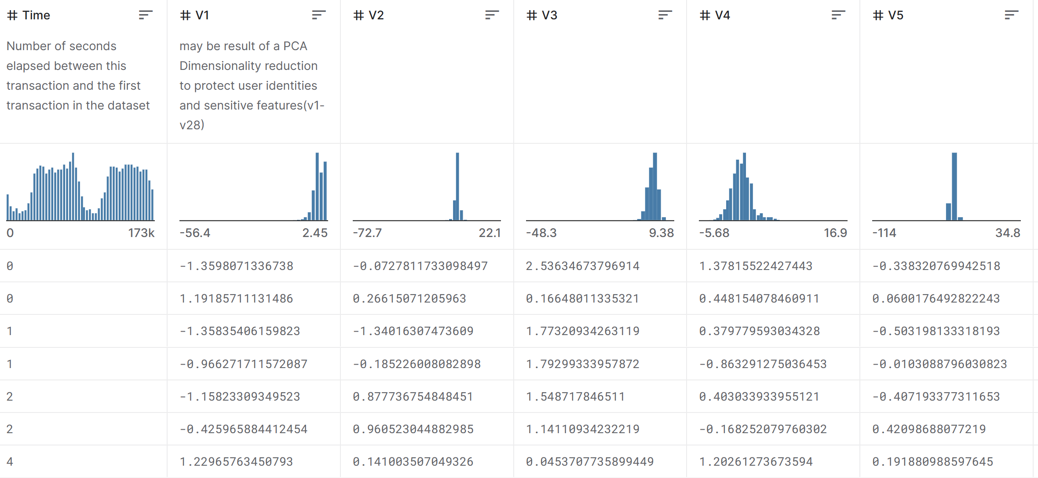

Principal components
Credit Card Fraud Detection Kaggle
https://www.kaggle.com/datasets/mlg-ulb/creditcardfraud
The dataset contains transactions made by credit cards in September 2013 by European cardholders. This dataset presents transactions that occurred in two days, where we have 492 frauds out of 284,807 transactions. The dataset is highly unbalanced, the positive class (frauds) account for 0.172% of all transactions. It contains only numerical input variables which are the result of a PCA transformation.

Slide 46
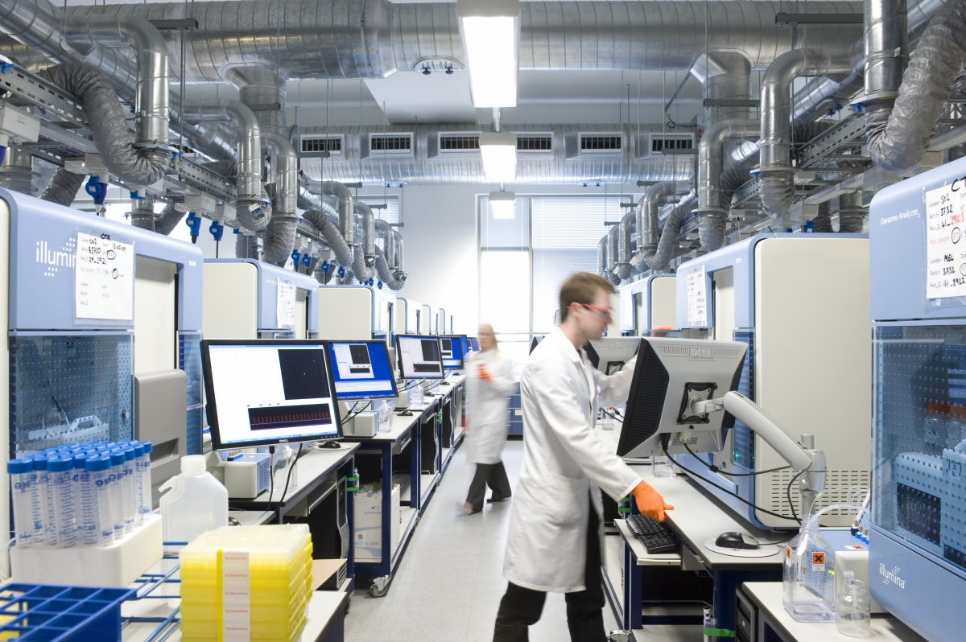


Wellcome Sanger Institute
University of Cambridge
https://www.sanger.ac.uk/

Slide 47
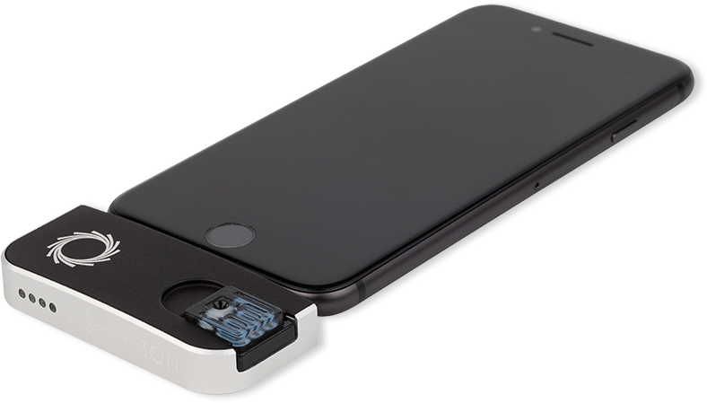


Oxford Nanopore Sequencer
University of Oxford U.K.

Slide 48
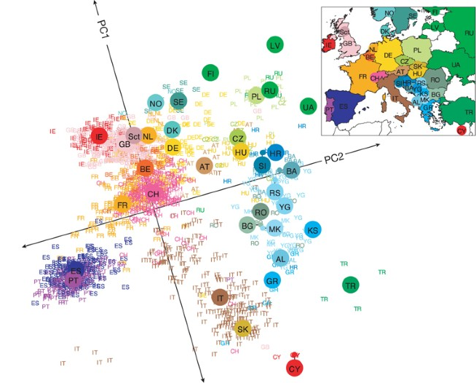

European diversity explained with DNA variation fingerprinting
Within a drop of blood, you can find all the information you need to reasonably guess where a person came from, without ever having to look at their face, name or passport. Small variations in our DNA are enough for the task. They can be used to pinpoint someone’s place of origin to a remarkable degree of accuracy, often to within a few hundred kilometres.

Slide 49
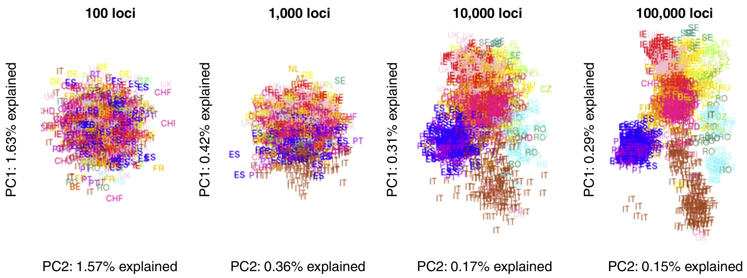

Slide 50
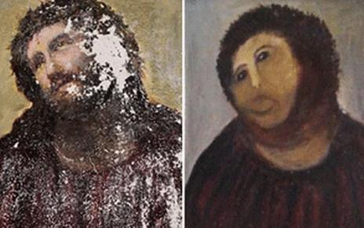
Elias Garcia Martinez's Ecce Homo (left) and its "Monkey Christ" rendition

Slide 51
Knowledge retrieval
method “bestiary”

Slide 52
KD¹ Summary
Hypothesis-free vs. hypothesis driven approach: Only few projects start with well-defined hypothesis and use data to prove it. More often than not, the data science projects start without clear understanding what to do.
Parametric vs. non-parametric methods: Nonparametric methods give you better fit at a cost of being not quite applicable on different data. Is it worth it be only good at forecasting yesterday’s stock gains/losses?
Supervised vs. unsupervised methods: Supervised methods are fit for prediction and inference, whilst unsupervised are good for classification. Nether exclusively works with big data, but both show preference for either long or wide data.

